Slide 1
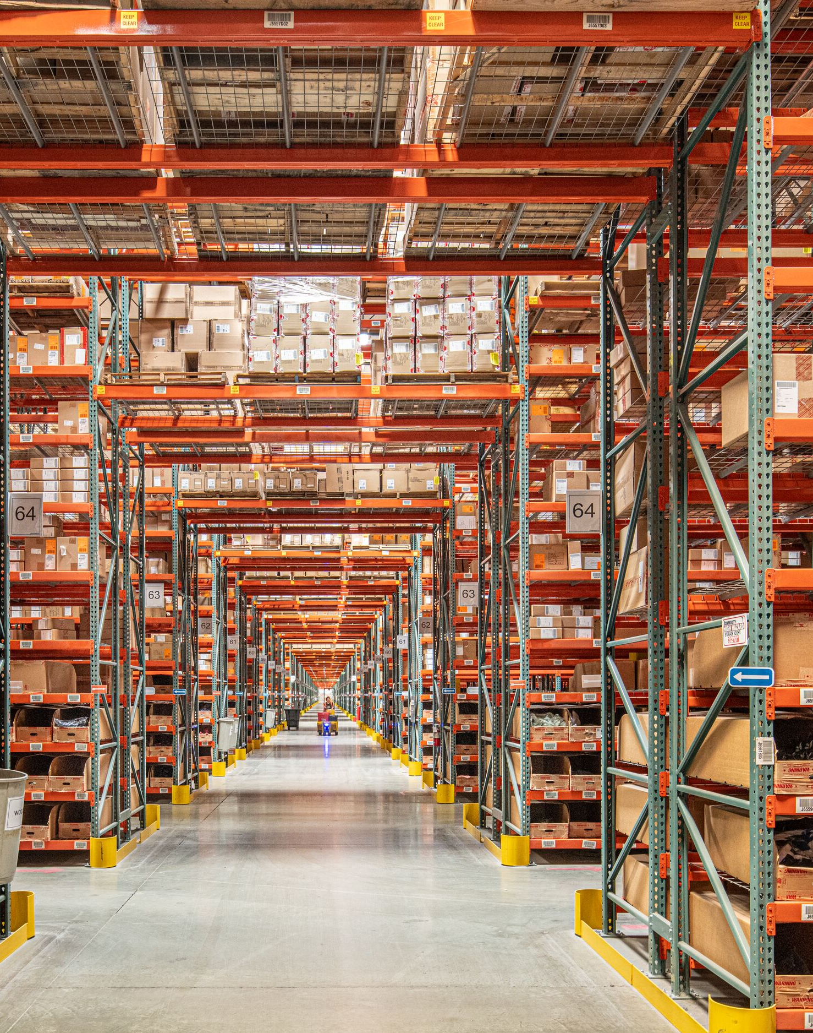

IE 6650 Final Project
Warehouse Design
Group Members:
Pranav Joshi
Nishank Sathe

Slide 2
Problem Statement
To design a warehouse facility for the distribution of groceries given order quantity and hourly demands of SKUs.
Products arrive from suppliers in cartons on pallets in quantities indicated in “order quantity.” All cartons on a pallet contain the same SKU (i.e., no inbound mixed pallets) and the number of cartons on each pallet is in “cartons/pallet.”
Orders from customers are for one or more SKUs and each order can be for cartons, pallets, or both. The average weekly quantities for cartons and pallets are also found in “hourly demand.”
The minimum practical number of locations for each SKU to be placed in the forward area has been determined and indicated in “min practical number.”
All aisles in the warehouse are 15 ft. wide
Busiest hour in the facility in the past year required 350 moves
All pallets are 48”x48”.
Forward area is single high, single deep and has 75 locations.
Pick from forward area (pallet on ground) = 3 minutes
Pick from reserve area = 5 minutes
Replenish forward area from reserve = 4 minutes

Slide 3
Problem Statement
Considering shipping and receiving are located in the same general area design facility to
Minimize picking time in the forward area and
Minimize the wasted floor space in the reserve area.
Also, determine the number of forklifts needed as well as the labor requirements to staff this facility.

Slide 4
Assumptions
Forklift speed – 150 feet/min
Material Handling Equipment Distributors Association (MHEDA) recommends a 3-mph max speed in high pedestrian traffic areas.
Loading and unloading time – 15 seconds each
Material Handling 3 PPT – Slide No 16
Cartons are picked individually, i.e., one move per carton
The forklifts follow the centerline of the aisle

Slide 5


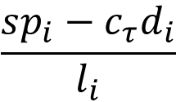
Computational Approach
$$\frac{s{(p}_{j}+D_{j})}{u_{i}}$$
Immediate candidates for complete inclusion
Rest (first bid is for l_{i})
When an iteration puts li in the forward area, then remaining pallets of that SKU (ui – li ) have a bid that is added to the list
ui - number of locations required to store all in forward
li - minimum practical number of locations if we store any of SKU i here, it will be in li locations
Di - Pallet picks/day
pi – Carton picks/day
di -Replenish (pallets)/day
$$\frac{sp_{i}−c_{τ}d_{i}}{l_{i}}$$
$$\frac{sD_{i}+c_{τ}d_{i}}{{u_{i}−l}_{i}}$$
Picking Times
Reserve
Forward
c_{τ} (min/replenish)
s = c₂ – c₁
c₂ (min/pick)
c₁ (min/pick)

Slide 6
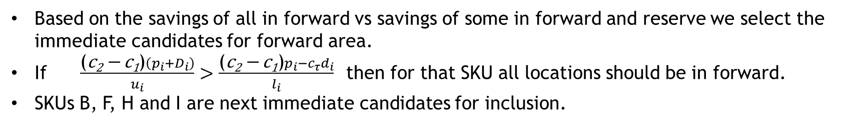
Selecting Immediate Candidate for Forward Area
Based on the savings of all in forward vs savings of some in forward and reserve we select the immediate candidates for forward area.
If $\frac{\text{(}\text{c}\text{2 }\text{− }\text{c}\text{1}\text{)}\left(p_{i}+D_{i}\right)}{u_{i}}>\frac{\text{(}\text{c}\text{2 }\text{− }\text{c}\text{1}\text{)}p_{i}−c_{τ}d_{i}}{l_{i}}$then for that SKU all locations should be in forward.
SKUs B, F, H and I are next immediate candidates for inclusion.

Slide 7
Bidding for Remaining Locations in the Forward Area
The SKUs other than immediate candidates bid for minimum practical locations in the forward area.
The SKUs G,C,J,D,A,E should have minimum practical locations in forward area.
There are still 17 locations available in the forward area that are filled by selecting SKUs based on the (ui-li) bid.
From these 17 locations; SKU C gets 11 locations and SKU G gets 6 locations.

Slide 8
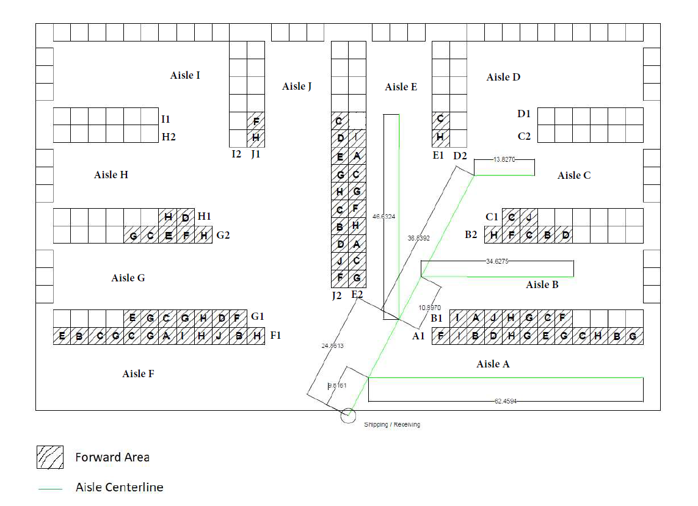
Facility layout

Slide 9
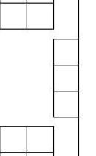
Designing Facility to Minimize Picking Time and Wasted Floor Space
The combination of vertical and horizontal aisles reduces the maximum distance.
To minimize the distance traveled to access the aisles, angular aisles are introduced from the shipping/receiving area.
75 nearest locations from shipping/receiving are selected for the forward area.
Instead of putting hard walls at the end of aisles, pallets are placed to efficiently utilize the space and reduce the overall facility footprint.

Slide 10
Allocation of SKUs in the Forward Area
SKUs with a high number of carton orders should be closer to the shipping/receiving area, considering single carton pickup in each trip and minimizing the total distance traveled.
SKUs with overall high demand should be closer to the shipping/receiving area considering the higher number of moves requirement.
SKUs with multiple locations in the forward area should not be placed together to avoid congestion and should be evenly distributed across the forward area.
SKUs with relatively high pallet orders compared to carton orders should be placed at farther locations in the forward area since pallet order requires a single move.

Slide 11
Forward Area – Total Distance Travelled Calculations
Total Distance Travelled for = SKU Pickup in Forward Area
Number of moves for carton pickup * Carton location + Number of moves for pallet pickup (1) * Pallet location
Cartons are picked from the nearest SKU location, whereas full pallets are picked from relatively farther locations.
This ensures total distance traveled to meet the demand for that particular SKU is minimized since carton pickup requires more moves, and they are picked from the closest locations.

Slide 12
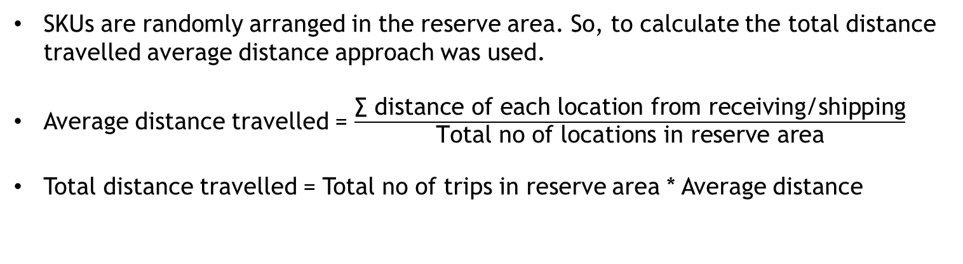
Reserve Area – Total Distance Travelled Calculations
SKUs are randomly arranged in the reserve area. So, to calculate the total distance travelled average distance approach was used.
Average distance travelled = $\frac{\text{∑} \text{distance} \text{of} \text{each} \text{location} \text{from} \text{receiving}\text{/}\text{shipping}}{\text{Total} \text{no} \text{of} \text{locations} \text{in} \text{reserve} \text{area}}$
Total distance travelled = Total no of trips in reserve area * Average distance

Slide 13
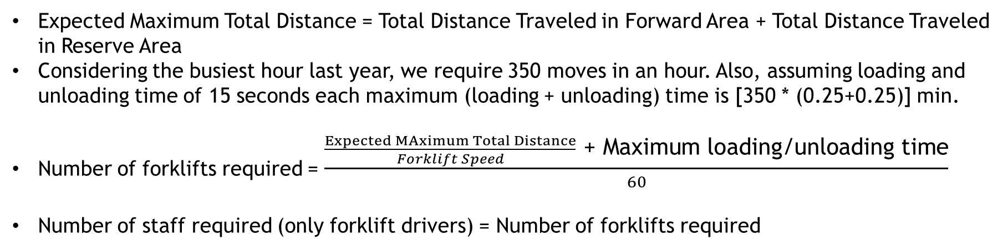
Determining Forklift and Staff Requirement
Expected Maximum Total Distance = Total Distance Traveled in Forward Area + Total Distance Traveled in Reserve Area
Considering the busiest hour last year, we require 350 moves in an hour. Also, assuming loading and unloading time of 15 seconds each maximum (loading + unloading) time is [350 * (0.25+0.25)] min.
Number of forklifts required = $\frac{\frac{Expected MAximum Total Distance}{Forklift Speed}\text{ + }\text{Maximum} \text{loading}\text{/}\text{unloading} \text{time}}{60}$
Number of staff required (only forklift drivers) = Number of forklifts required

Slide 14
Conclusion
Facility design is a complex task and requires considering various factors. There could be more than one correct approach.
Layout of a facility depends upon aisle width, lane depth, the height of pallet stack, shipping/receiving location, minimum practical locations, etc.
SKU pallet and carton demand are vital in designing the forward area.
Number of forklifts depends upon the type of operation i.e., Single or Dual command, loading/unloading time and total distance traveled.

